Slide 1
VEMA POOJITHA
Final Project
Keylogger Techniques, Understanding Methods

Slide 2
KEYLOGGER & SECURITY
Keyloggers are software tools that record a user's keyboard input, including passwords, credit card numbers, and other sensitive information. They can be used for both legitimate and malicious purposes, making them a powerful but controversial technology.

Slide 3
AGENDA
A keylogger is a key stroker/keyboard capturing is a form of malware or hardware that keeps track of and records your keystrokes as you type.
It takes the information and sends it to a hacker using a command-and-control (C&C) server.
The hacker then analyzes the keystrokes to locate usernames and passwords and uses them to hack into otherwise secure systems.

Slide 4
PROBLEM STATEMENT
Keylogger Threats
Keyloggers pose a serious security risk by secretly recording a user's keyboard input, potentially exposing sensitive information like passwords and financial data.
Lack of User Awareness
Many users are unaware of keylogger threats or lack the knowledge to effectively safeguard their devices and online activities.
Inadequate Security Measures
Existing security solutions may not provide comprehensive protection against sophisticated keylogger attacks, leaving users vulnerable.

Slide 5
PROJECT OVERVIEW
First we install the python ide and then we install the two packages.
First one is pip pynput install.
pip install pynput
Next one is jsons library.
pip install jsons
Then these two are used for controlling mouse and keyboard.
So we can use for keylogger security.
Above like that you can install it in command prompt.
By these two libraries we cannot get error in python code.

Slide 6



WHO ARE THE END USER?
IT Security Professionals
The primary end users for this keylogger security solution are IT professionals responsible for protecting their organization's networks and devices from cyber threats.
Business Executives
Business leaders and decision- makers who need to safeguard sensitive company data and ensure the overall security of their digital infrastructure will also benefit from this solution.
Remote Employees
With the rise of remote work, this keylogger security tool can help protect employees accessing company systems and data from their personal devices outside the office network.

Slide 7
YOUR SOLUTION AND IT’S VALUE PROPOSITION
Solution: Implement a multi-layered security strategy that includes anti-keylogging software, regular system scans, software updates,and user education.
Value Proposition:
Enhanced Security: Reduces the risk of data breaches and
identity theft.
User Awareness: Educates users about keylogging threats and
protection methods.
Compliance: Helps businesses and organizations comply with
data protection regulations.

Slide 8
THE WOW IN YOUR SOLUTION
Our security solution goes beyond traditional keylogger detection by leveraging advanced machine learning algorithms to proactively identify and neutralize evolving threats. This cutting-edge technology provides unparalleled protection, delivering a seamless user experience without compromising security.

Slide 9
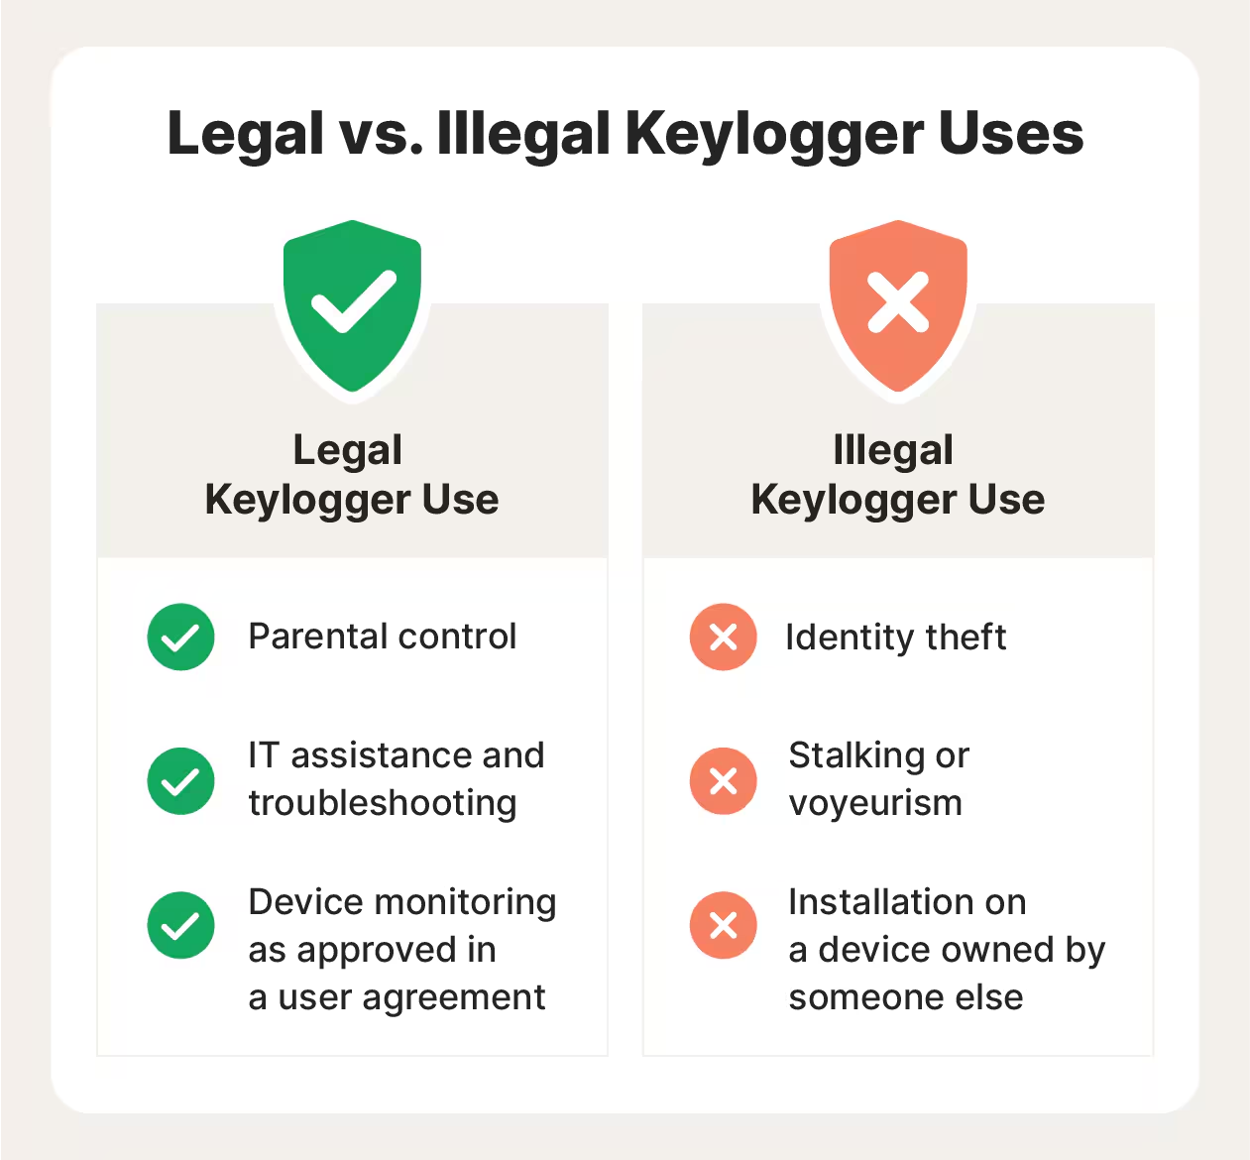

Slide 10
MODELLING
Teams can add wireframes
Architecture Overview:
Modular Design: The keylogger code is structured into
modular functions for better readability
and maintenance.
Event Handling: Utilizes the pynput library to capture and
handle keyboard events.
Data Logging: Implements functions to log captured data
into text and JSON files.

Slide 11



Data Gathering
Collect relevant data on user behavior, system logs, and security vulnerabilities to inform the model development process.
Model Training
Train a machine learning model using advanced techniques like deep learning or anomaly detection to identify patterns indicative of keylogger activity.
Feature Engineering
Identify and extract the most relevant features from the data to build a predictive model that can detect and prevent keylogger intrusions.

Slide 12
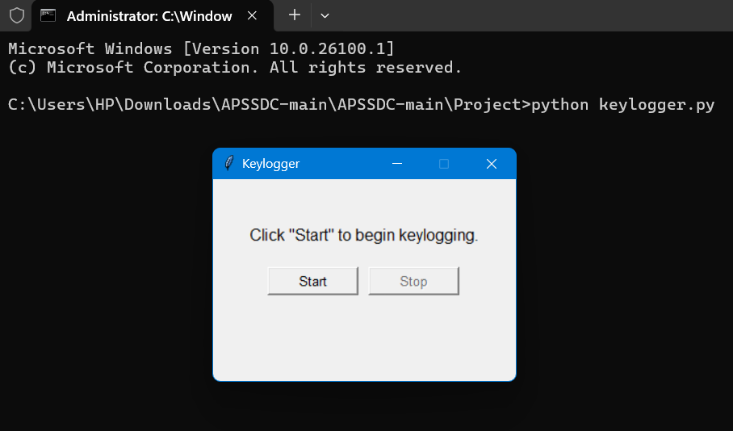
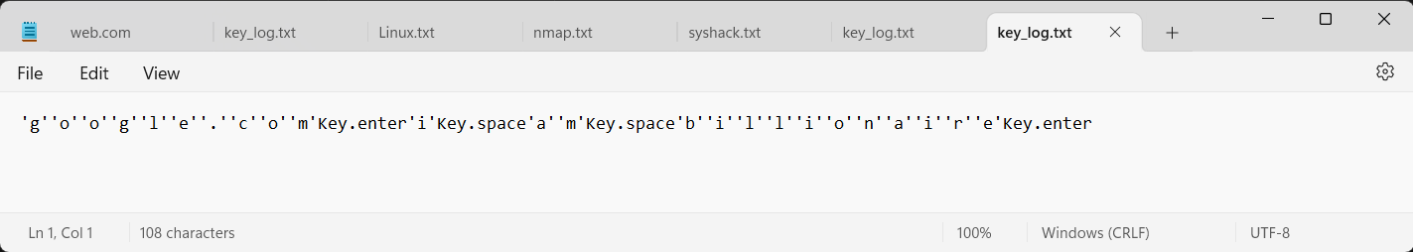
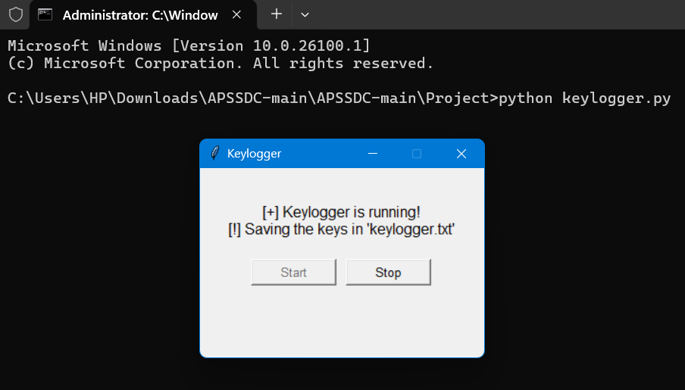
RESULTS
The result of a keylogger program typically involves capturing and logging keystrokes entered by a user on a keyboard. These logged keystrokes can then be used for various purposes, depending on the intent of the keylogger user. The covert nature of keyloggers allows them to capture sensitive information, including passwords, personal messages, and financial details, without the user's knowledge or consent.

Slide 13
Github link
https://github.com/Vemapoojitha/keylogger-and-security

